Slide 1
HTML
Introduction to HTML
Computer Science Department

Slide 2
HTML INTRODUCTION
HTML stands for Hyper Text Markup Language. An HTML file is actually a text file containing small markup tags
The markup tags tell the Web browser how to display the page
An HTML file must have an htm or html file extension (e.g. about.html, faculty.html)
An HTML file can be created using a simple text editor (e.g. Notepad)

Slide 3
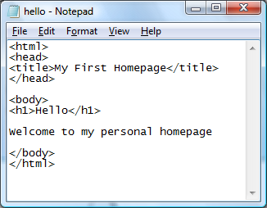
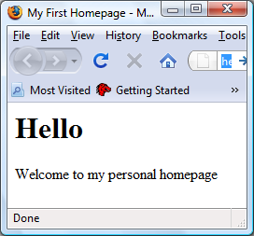
HTML AT A GLANCE
HTML code written using Notepad. It is saved as “hello.html”
Hello.html page as interpreted by the web browser. Eg: Internet Explorer

Slide 4
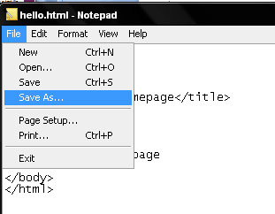
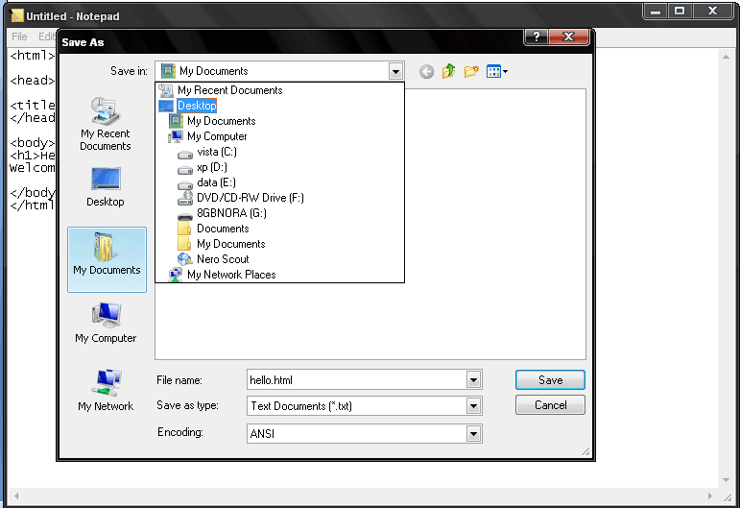

Slide 5
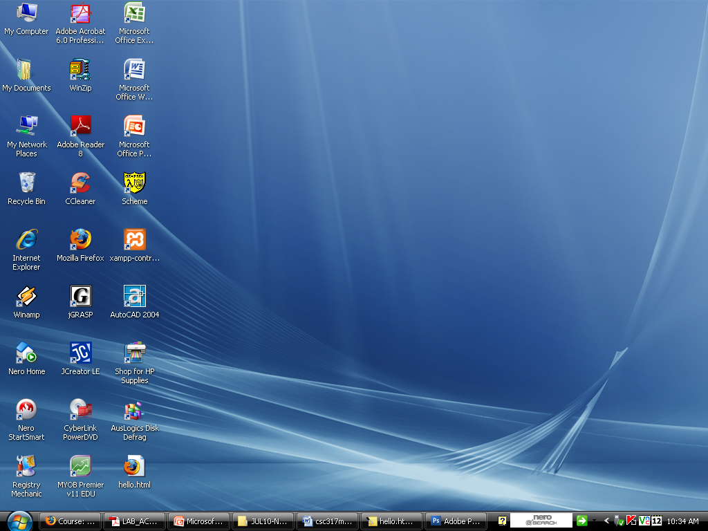
Hello.html is indicated in web browser file

Slide 6
HTML
HTML documents are text files made up of HTML elements.
HTML elements are defined using HTML tags.
HTML Tags
  HTML tags are surrounded by angle brackets, < and >
  HTML tags usually come in pairs like <p> which is the start tag and </p> which is the end tag.
  You will write the element content between the two tags.
  HTML tags are not case sensitive. <p> will be treated as <P>.

Slide 7
HTML TAGS
“hello.html” has five HTML tags:
<html>
<head>
<title>
<body>
<h1>
The highest hierarchy is <html>. <html> tags has a few child tags such as <head> and <body>.
Child tags must be placed inside the parent tag. As you see <title> is placed inside the <head> tag.
<body> tags can contains most of other tags such as <h1>, <table>, <p>, and many more.
Inside <title>… </title> you can write any text as a title of home page.
The purpose of the <body> tag is to define the HTML element that contains the body of the HTML document.

Slide 8
HTML BASIC TAGS
<body>…</body>
<body bgcolor = “colorname”> - default color is white
<body background = “image.gif/.png/.jpg”>
The image must be located in the same location as the HTML file.

Slide 9

Image file named ‘cat’ is located on the desktop. This is a JPEG file, its extension is .jpg.

Slide 10
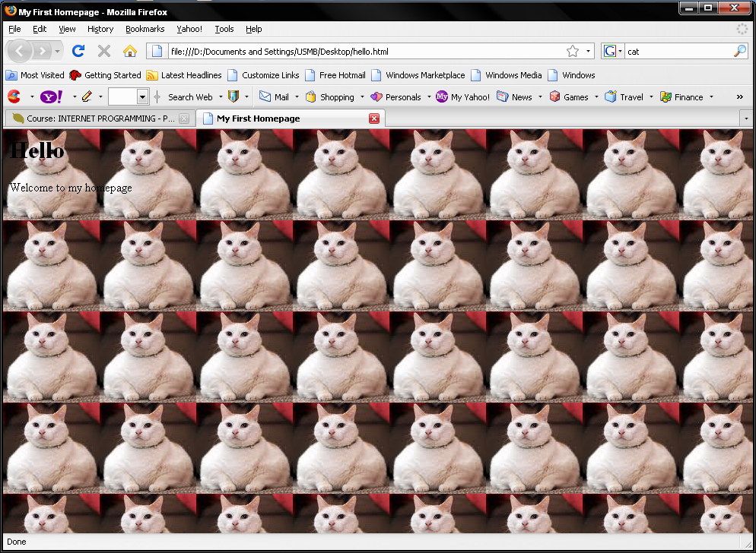
<body background="cat.jpg">
Small image will be tiled to fit the browser window size

Slide 11
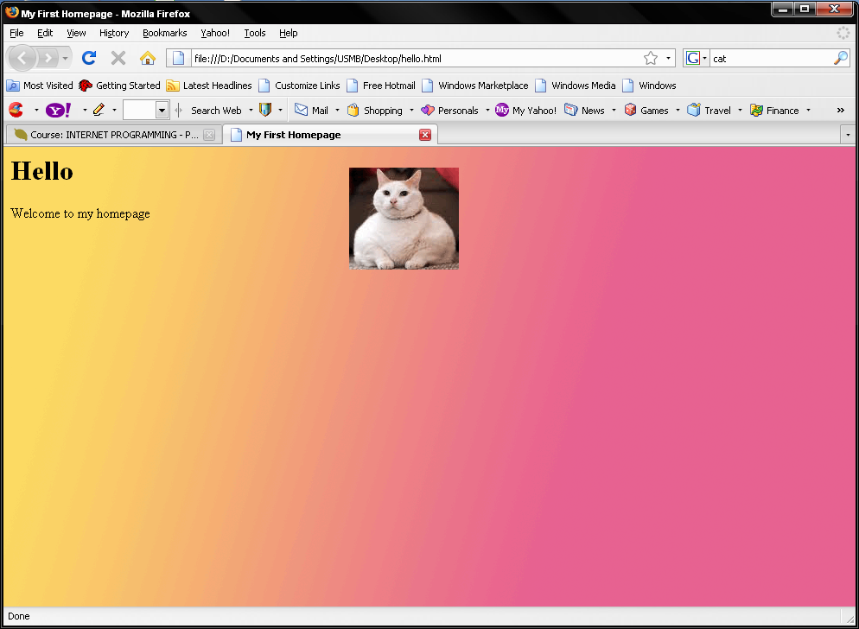
A large image will fit nicely in the browser window size
<body background="catbg.gif">

Slide 12
OTHER TAGS
Headings
For header of a page, to indicate title
<h1> … <h6>
Eg: <h1>Welcome</h1>
Paragraph
<p>Welcome to my homepage</p>
Line break
<br>
Comment
<!– This is a welcome page -->

Slide 13
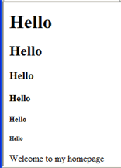
<H1>… <H6>
<h1>Hello</h1>
<h2>Hello</h2>
<h3>Hello</h3>
<h4>Hello</h4>
<h5>Hello</h5>
<h6>Hello</h6>
Welcome to my homepage

Slide 14

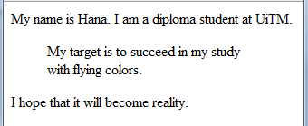
<pre>… </pre>
To preserve the appearance of information
  <pre>
  Name : Hana
  Course: Computing
  </pre>
<blockquote>… </blockquote>
Used to indicate quotation

Slide 15
OTHER TAGS
<hr> Horizontal line
width, size, align
Eg: <hr size= “3”> <hr width=“50%”>
<hr align = “right”>
<hr size=“3” align=“left”>
Default: Size=“2”, Align=“Center”, Width=“100%”

Slide 16
TEXT FORMATTING
<b>This is bold</b>
<i> This is italic </i>
<strong> This is strong </strong>
<sub> … </sub>
<sup> … </sup>

Slide 17
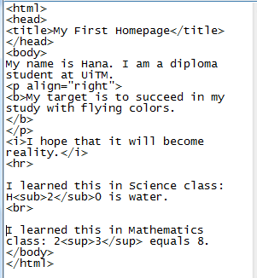
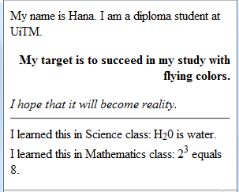

Slide 18

FONT FORMATTING
<font> … </font>
Attribute: size, face, color
Eg: <font face=“Arial” color=“blue” size=“5”>

Slide 19
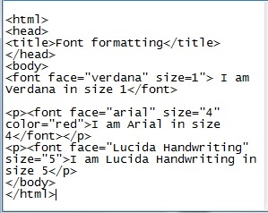
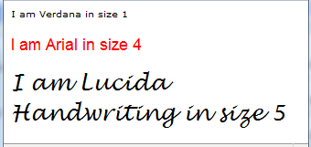

Slide 20
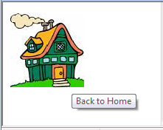
IMAGES
<img src=“img.gif”>
<img src="home.jpg" width="100" height="100" alt="Back to Home" >
Attributes | Description
src | The location of image
width | Width of the desired image
height | Height of an image
alt | Is used to give label to image

Slide 21
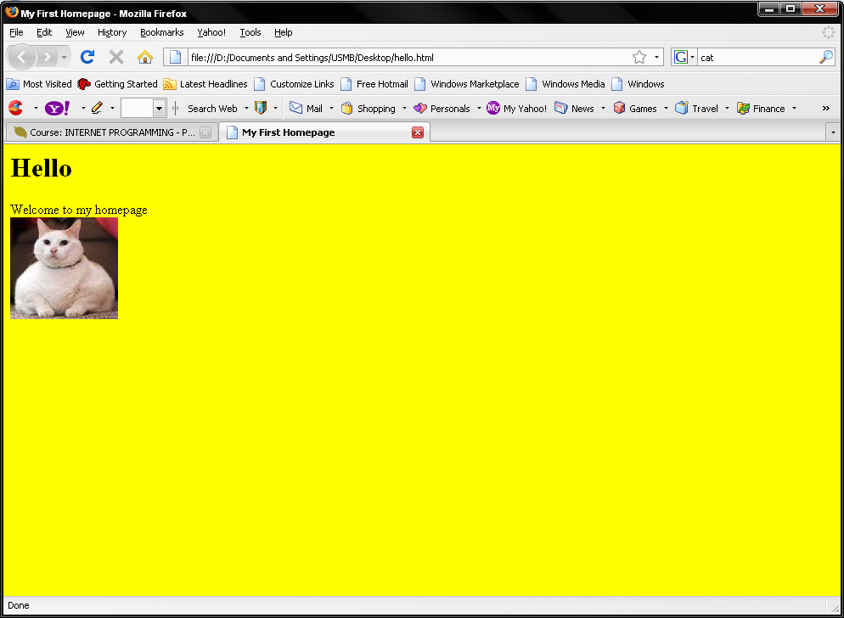
<html>
<head>
<title>My First Homepage</title>
</head>
<body bgcolor="yellow">
<h1>Hello</h1>
Welcome to my homepage
<br>
<img src="cat.jpg">
</body>
</html>

Slide 22
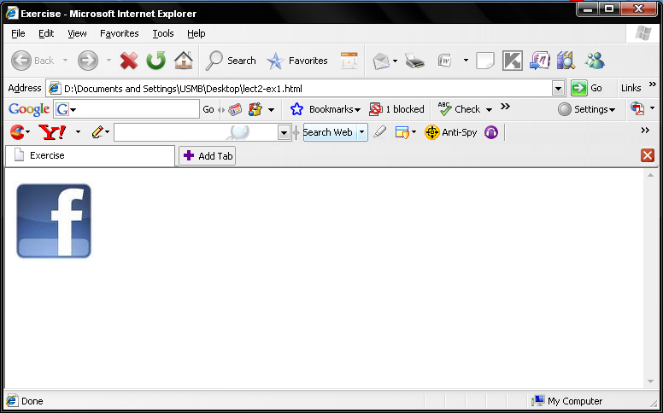
EXERCISES
Write the code to produce this page:

Slide 23
ANSWER
<html>
<head><title>Exercise</title>
</head>
<body>
<img src = "fblogo.jpg">
</img>
</body>
</html>

Slide 24
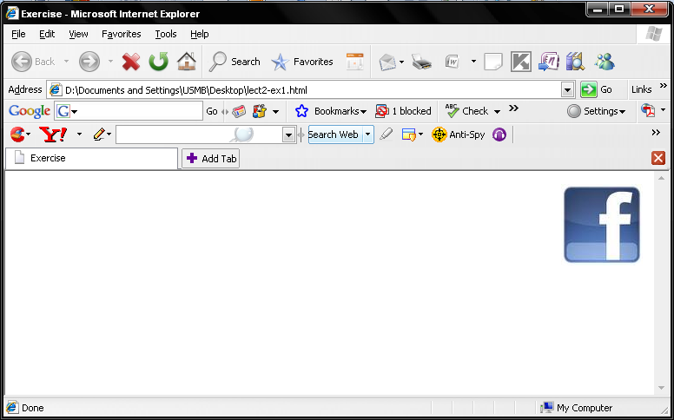
EXERCISES

Slide 25
<html>
<head><title>Exercise</title>
</head>
<body>
<img src = "fblogo.jpg" align="right">
</img>
</body>
</html>

